Slide 1
The NAP5 Activity Survey
Mike Sury
September 2014

Slide 2
Previous estimates of activity
NAP4 estimated the number of general anaesthetics
  ~ three million (2,872,600) per year

Slide 3
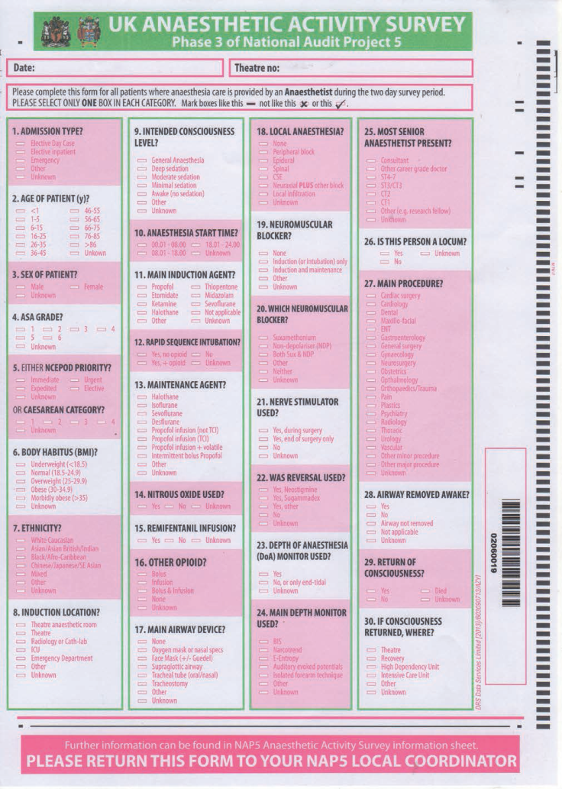
Data collection methods
Every patient over 2 days in September 2013
  Only NHS patients in NHS hospitals
  Any surgical, diagnostic or interventional procedure where an anaesthetist (of any grade) was responsible for patient care
  Any location (ICU, ED, Radiology, Delivery Ward)

Slide 4
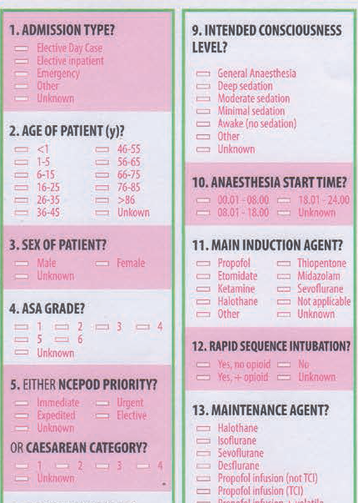

Slide 5
Calculations
Scaling factor from 3 components:
  conversion of two days to a week (3.5)
  the number of working weeks in 2013 (50.59)
  median return rate from LCs (0.98)
  (3.5 x 50.59)/0.98 = 180.68
Annual caseload estimations were rounded to the nearest 100.
  NB an estimated annual caseload of 200 or 400 represents 1 or 2 returns respectively
All calculations were made using Microsoft Excel 2010 and the ‘PivotTable’ facility.

Slide 6
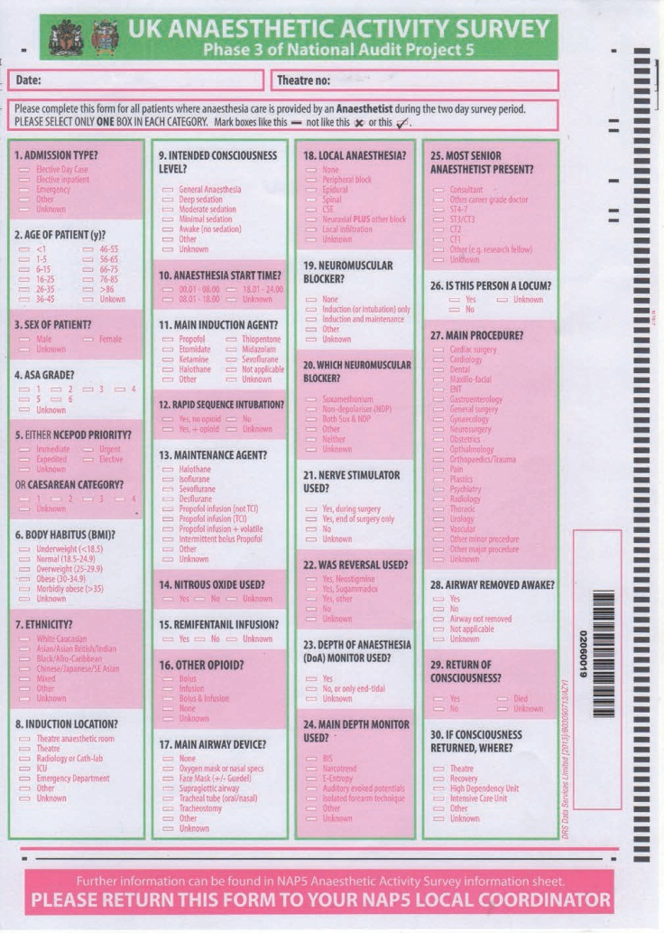
Results
20,400 forms were returned = annual caseload of 3,685,800
Unanswered questions
  Overall <4%
  2 questions >20%
    Which neuromuscular blocker was used?
    Main depth monitor used?

Slide 7
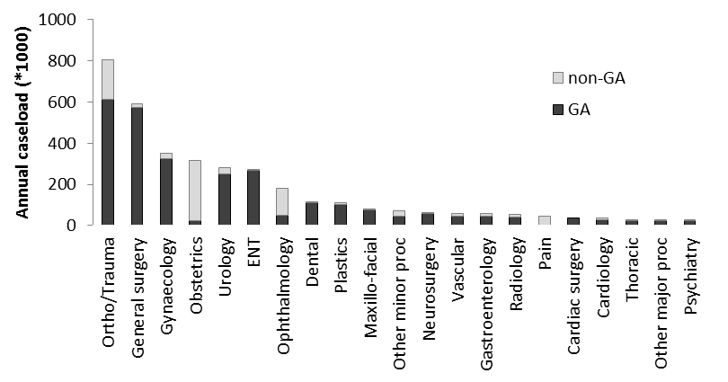
Main procedure

Slide 8
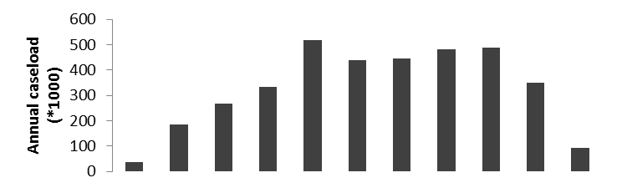
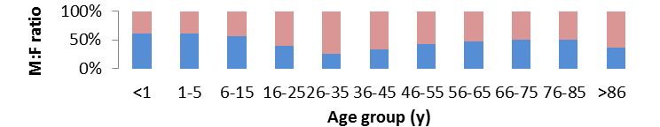
Age and sex

Slide 9
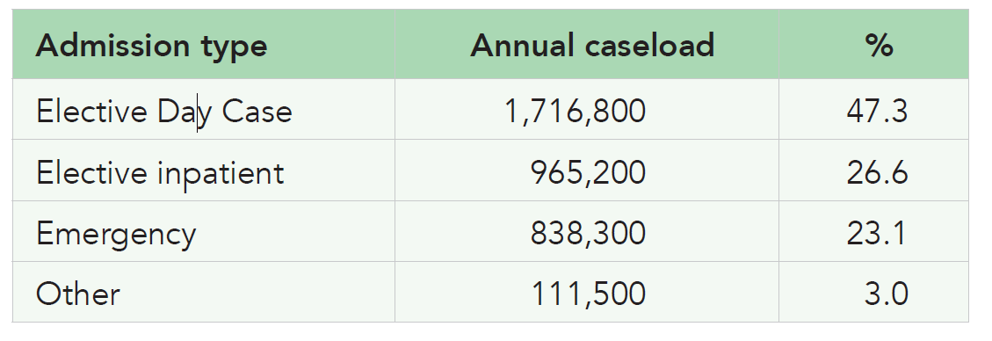
Admission type

Slide 10
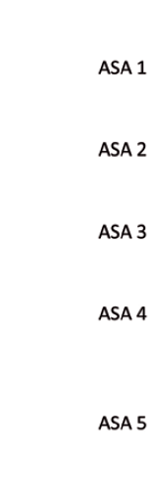
Time of day

Slide 11
Time of day

Slide 12
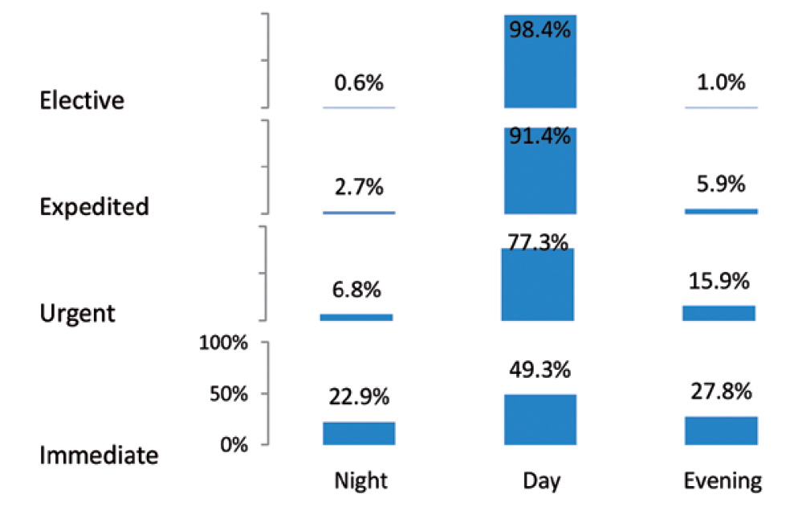
Time of day

Slide 13
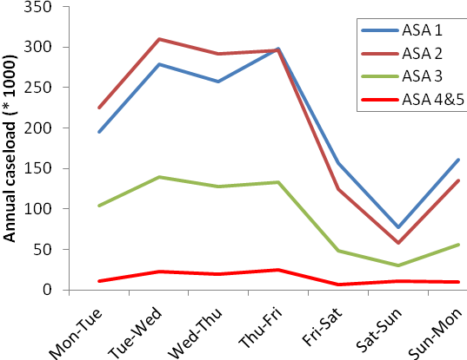
Day of week & ASA

Slide 14
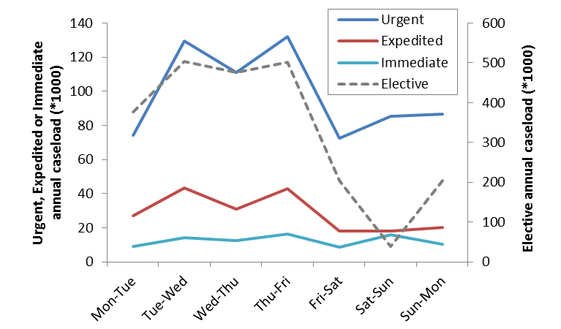
Day of week & Urgency

Slide 15
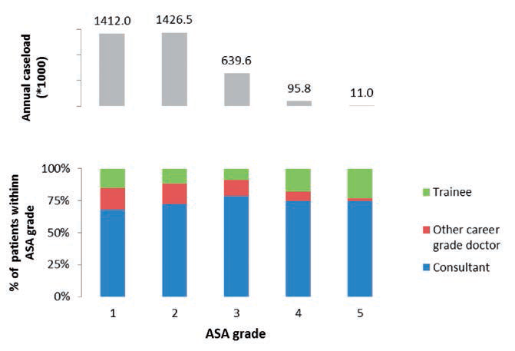
Seniority of Anaesthetist

Slide 16
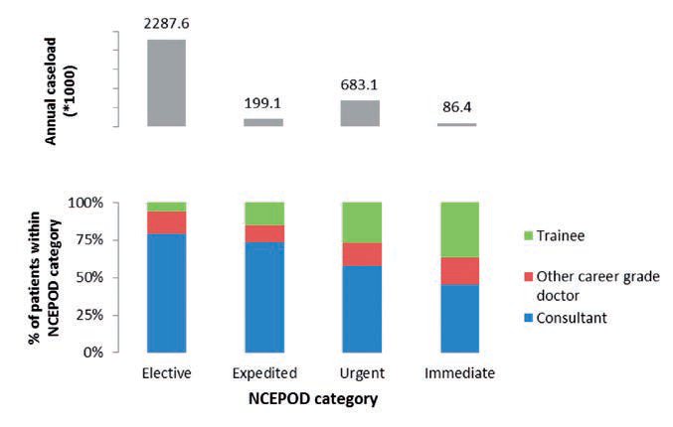
Seniority of Anaesthetist

Slide 17
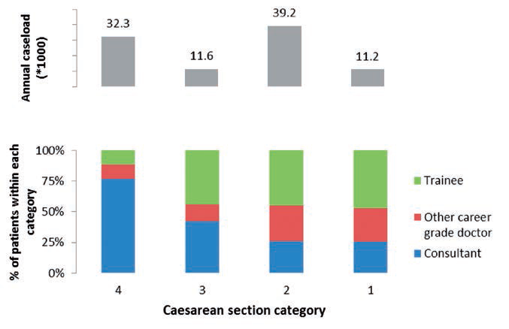
Seniority of Anaesthetist – obstetric

Slide 18
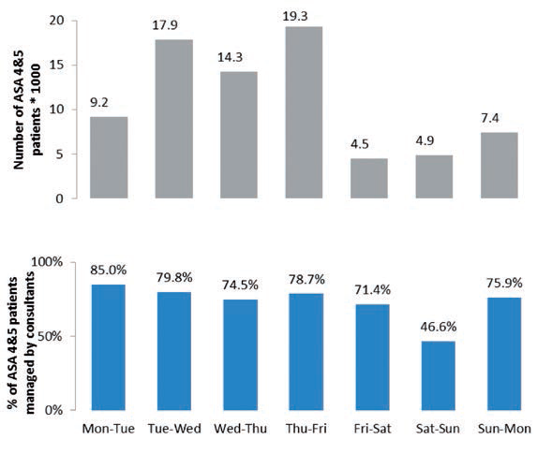
ASA 4 & 5

Slide 19
Intended Conscious level (LOC)
GA | 2,766,600 | 76.9%
Sedation (of any level) | 308,800 | 8.6%
Awake | 523,100 | 14.5%

Slide 20
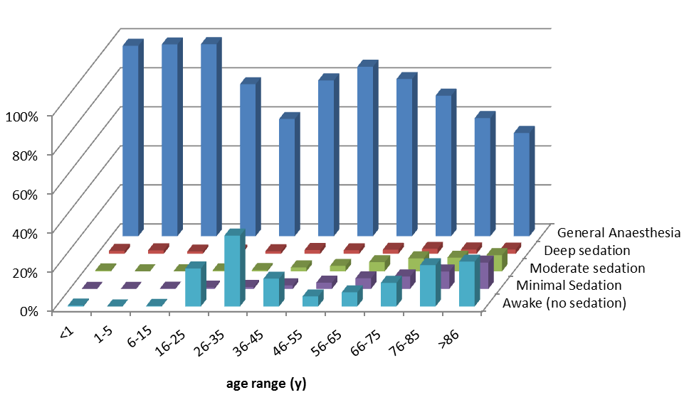
Intended LOC

Slide 21
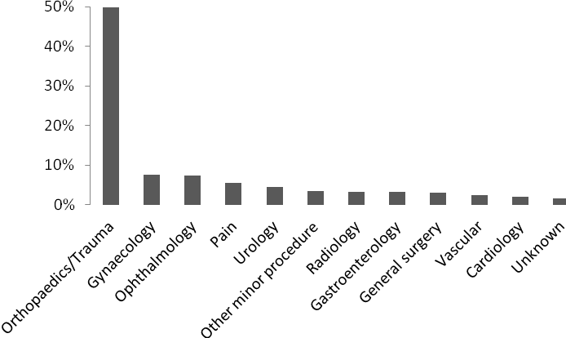
Sedation (all levels)
Sedation workload

Slide 22
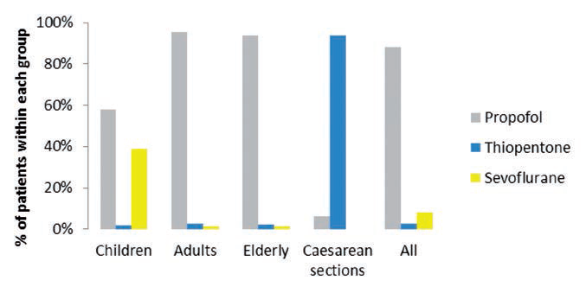
Induction agent

Slide 23
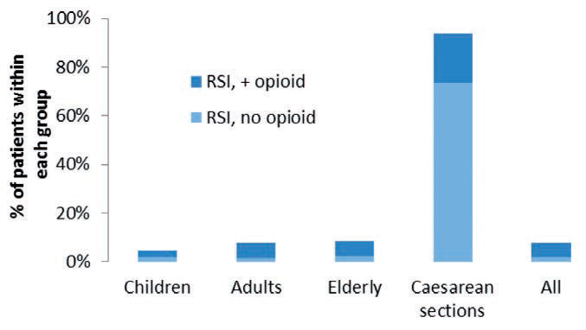
Rapid Sequence Induction (RSI)

Slide 24
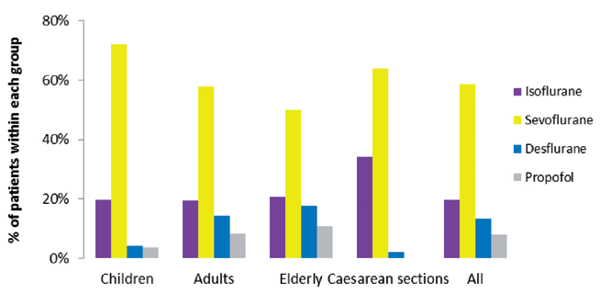
Maintenance agent

Slide 25
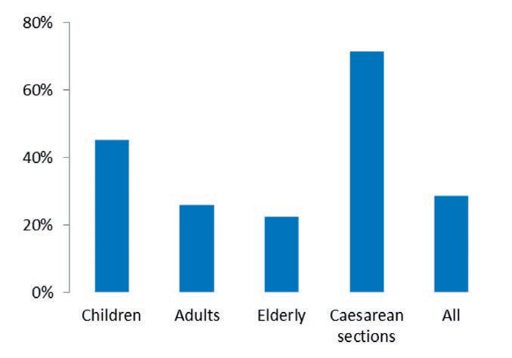
Nitrous oxide

Slide 26
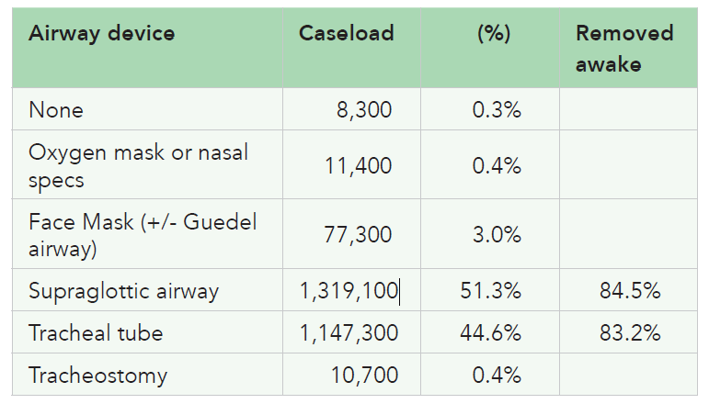
Main airway device used during GA

Slide 27
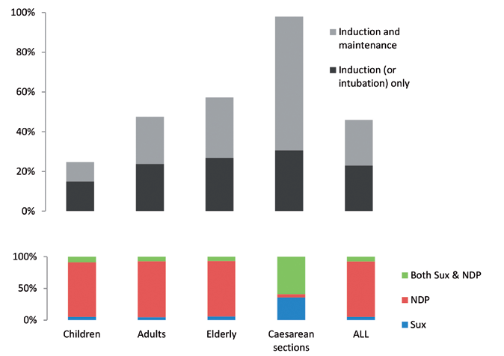
NMBs

Slide 28
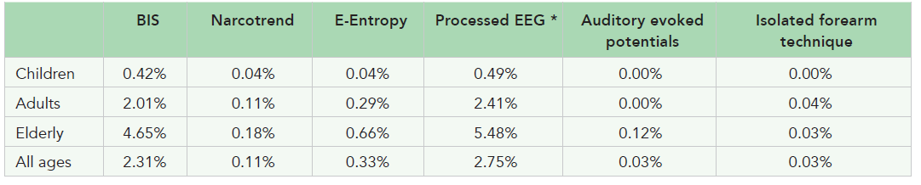
DOA monitors during general anaesthesia

Slide 29
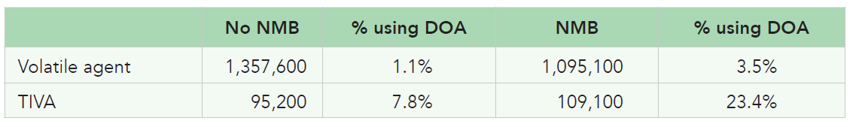
DOA monitoring: maintenance agent and NMB

Slide 30
4 learning points:
“most comprehensive national picture of anaesthesia practice to date”
NHS anaesthetists deliver approximately ~2.8 million general anaesthetics in a year
Non-GA ~ 25% of total activity

Slide 31
Challenges: consultant presence
Majority of patients are managed by consultants, irrespective of the patient’s ASA grade.
BUT consultants were present in
  57% of urgent and immediate cases
  26% of category 1 and 2 Caesarean sections
  For ASA 4 and 5 cases
    50% outside daytime hours v 80% during the daytime
    47% during weekends v 70% at other times of the week

Slide 32
Future?
In planning an anaesthetic service for a large population, datasets such as ours are likely to be valuable.
If major changes in anaesthesia are planned, we propose that another census should be undertaken to determine its effects

Slide 33
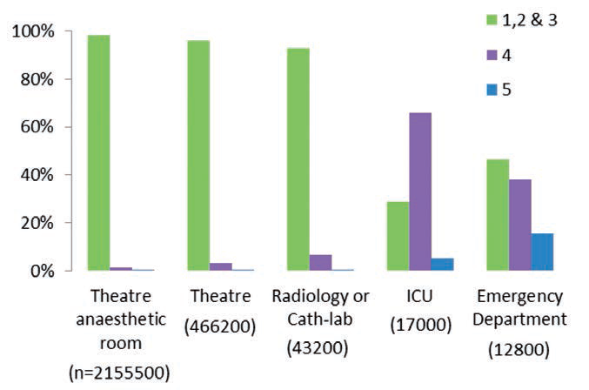
Location of induction

Slide 34
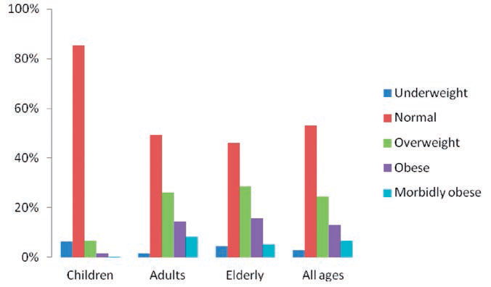
Obesity

Slide 35
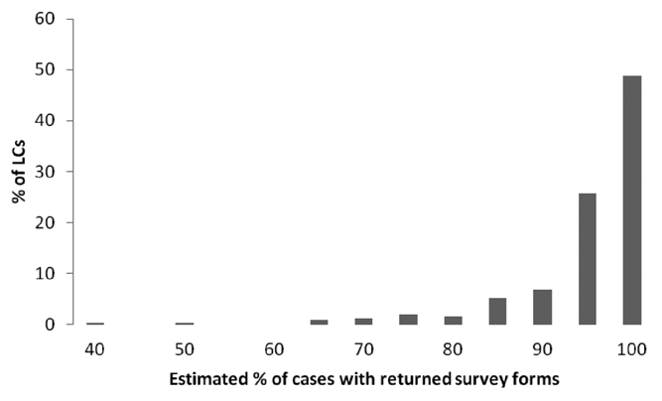
Results
All 267 LCs took part in the survey
  median return rate 98%

Slide 36
The Baseline Surveys

Slide 37
Methods
Survey
Conducted to guide main project
Conducted in 2012
All UK consultants & SAS doctors asked about their experience of new AAGA cases during 2011
Survey co-ordinated by LCs
Published BJA & Anaesthesia 2013

Slide 38
Results
7140 consultants
5951 SAS
265 centres
82% response rate (staff)
100% response rate (centre)
Demography of dept size, yrs experience – not to be discussed here

Slide 39
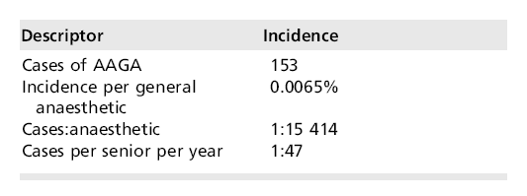
153 new AAGA cases
Using NAP4 denominator = incidence
~1: 15,000

Slide 40
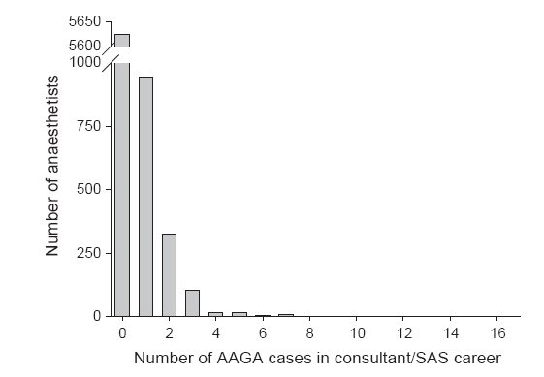
Histogram by anaesthetist in career

Slide 41
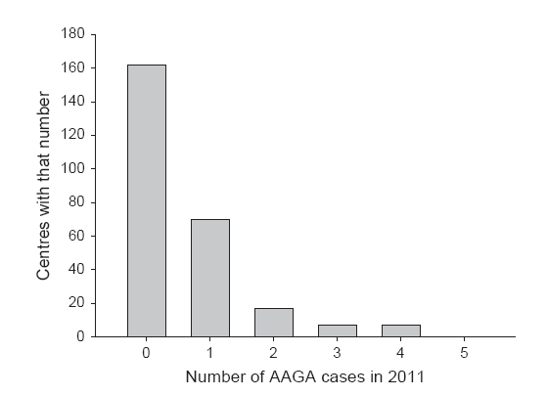
Histogram by centre for year

Slide 42
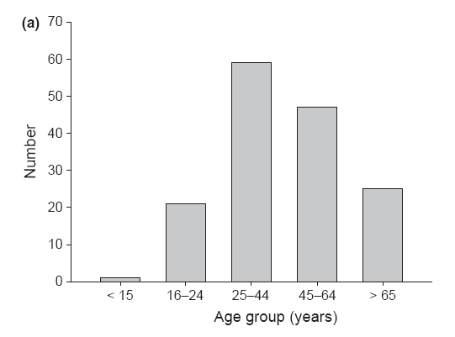
Age of AAGA cases
Most in young/middle age adults…(but no denominator)

Slide 43
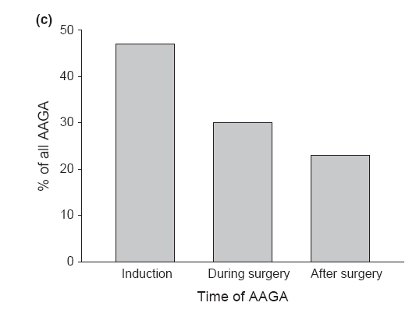
Timing of AAGA
Most in ‘dynamic’ phases of anaesthesia

Slide 44
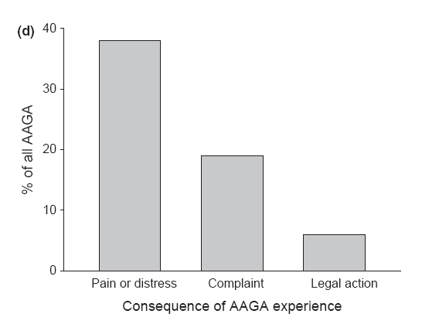
Consequence of AAGA
A minority distressed or in pain

Slide 45
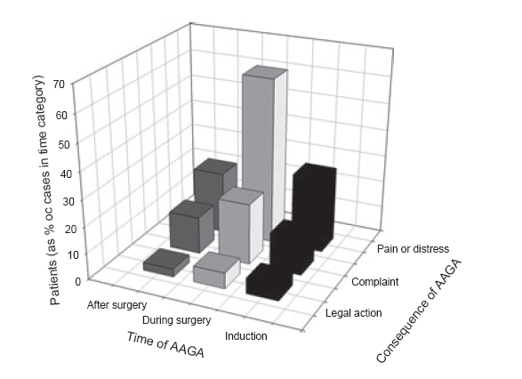
Pain/distress more likely during surgery than other phases

Slide 46
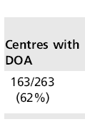
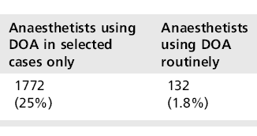
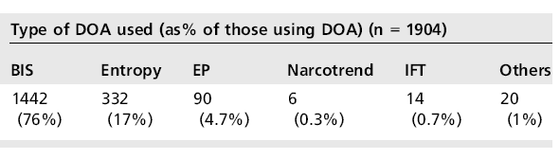
Use of DOA monitoring

Slide 47
Policies for preventing/managing AAGA
12/265 centres had any policy (4.5%)
Some were general critical incident policies; many were mini-reviews of AAGA

Slide 48
Conclusions
Baseline survey helped us plan main study
Reports of AAGA very much rarer than Brice questioning incidence (1:15,000 vs 1:600)
Most patients middle-aged
Most AAGA during induction and emergence
Pain/distress not universal (and in the minority)
Pain/distress more common with AAGA during surgery

Slide 49
Complaints or legal action very rare (<20% and <10% of AAGA cases)
Only 2/3rds centres have DOA monitor
75% of anaesthetists never use DOA
<5% centres have any relevant policies

Slide 50
Note these findings in light of main study
…will see little changed by main study; Baseline approach robust in main findings
END

Slide 51

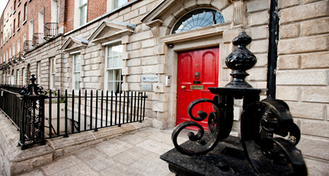
Dr Ellen O’Sullivan, Dublin
President,
College of Anaesthetists of Ireland
Notes:
Greeting for the CoAI
Thanks Pres-- Janice Fazackerly and sec Ewen forrest on behalf of the LSA and David Gray on behalf of the MSA for the kind invitation to speak….

Slide 52

Why is Ireland in NAP5?
Strong links with anaesthesia in UK through AAGBI & RCOA
Similarities re training / examinations & professional standards
BJA official journal of CAI

Slide 53
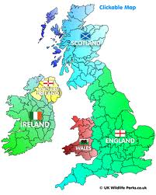
Why is Ireland in NAP5?
What we bring
Different healthservice structure
Private & public mix
Different use of DoA monitors
Internationalisation
Validation of NAP5 UK methodology
Generalisability
Increased impact
Notes:
Gain more global attention—national & international project..

Slide 54
Why is Ireland in NAP5?
What we get
First major audit in anaesthesia
Compare ourselves with UK
Self inquiry
Methodology and ‘raise our game’
Analysis
Reflection
A chance for action
Quality improvement
Notes:
Self-inquiry is very important—honesty in examining our own practice…
NEW CLEAR RECMMENDATIONS>>>>Quality improvement..

Slide 55
5th National Audit Project
RCOA + AAGBI
Republic of Ireland
(Public/HSE)
Baseline survey
(Published July 2014)
United Kingdom (NHS)
AAGA Reports
12 month data collection
AAS (Dec 2012)
Public Hospitals
Independent Hospitals
Baseline survey
(Published June 2013)
AAGA Reports
12 month data collection
AAS (Sept 2013)
NHS only
Notes:
oVCEWREVIEW OF PROJECTS AS DESCRIBED
BASELINE and then the Year long collection of datta
Essential data: GA used as the denominator in calculating incidence of AAGA
46 Public and 20 Independent hospitals
Approval DoH, HSE and Independent hospital Medical boards
As far as we are aware no other country have comprehensive data on the provision of anaesthesia services
Looking at the title of my talk today: Who operates, where when and on whom?
“Who” will be which specialies, “Where” will be a devided between Public and Independent Hospitals with a breakdown in the new hospitals groups, “whom and when” staffing and time of surgery.
Note that this only refers to the activity as anaesthetists and doesn’t include ICU duties, Pain etc.

Slide 56
Anaesthetic Activity Study
Denominator data for the study
Local Coordinators in 46 public & 20 independent hospitals-7days
Data =demographics, anaesthesia techniques, staffing, admission & discharge arrangements
Notes:
Phase 1 – Halfway into project. Very successful so far.
AASThe primary motivation for this survey was to obtain
denominator data for NAP5 in Ireland.
snapshot. Essential data: GA used as the denominator in calculating incidence of AAGA

Slide 57
Anaesthetic Activity Survey
Local Coordinators in 46 public & 20 independent hospitals
Data =demographics, anaesthesia techniques, staffing, admission & discharge arrangements
n=8,049 had anaesthesia care in 7days (26/11-3/12 2012)
  General anaesthesia 5,621 (69.8%)
  Regional anaesthesia 1,404 (17.4%)
  Local anaesthesia 290 (3.6%)
  Sedation 618 (7.6%)
  Monitored anaesthesia care 116 (1.4%)
Annual estimate of 426,600 cases

Slide 58
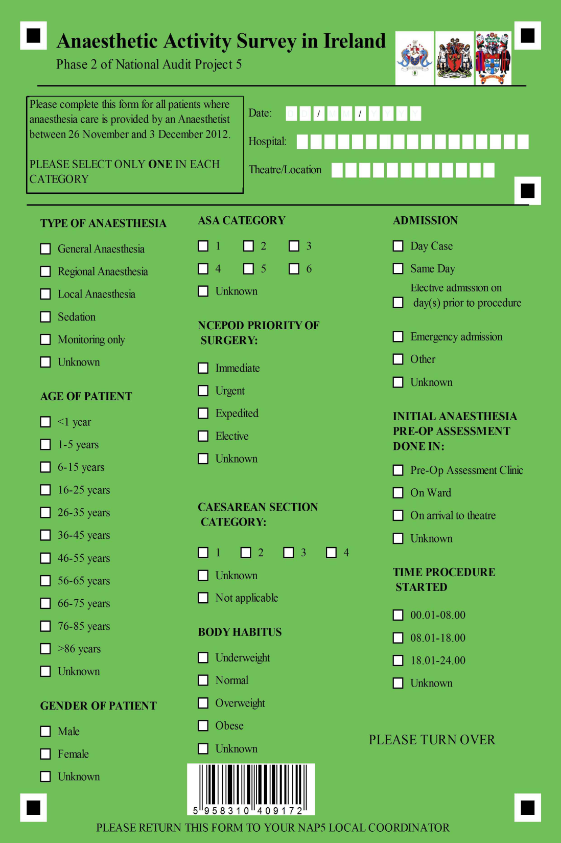
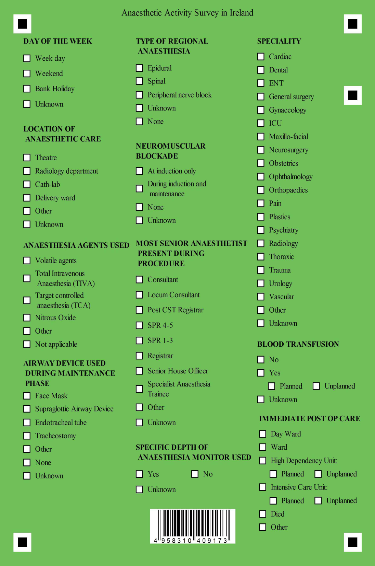
Notes:
Patient demographics:
i.e. age, gender, body habitus, ASA etc.
Admission and discharge detail:
elective, emergency, same day, ward, SDW, HDU, ICU
Peri-op detail:Patient demographics:
i.e. age, gender, body habitis, ASA etc.
Admission and discharge detail:
elective, emergency, same day, ward, SDW, HDU, ICU
Peri-op detail:
Pre-op assessment, NCEPOD, staffing, time of surgery, speciality, TIVA etc.
Pre-op assessment, NCEPOD, staffing, time of surgery, speciality, TIVA etc.
The project depended on Local coordinators as well as every individual Anaesthetist

Slide 59
8058
Forms returned
9
Forms rejected
8049
Analyzed
Estimated
~426,600 cases/year
Notes:
Multiplication factor of 50.84
Annual incidence of ~8.9 anaesthetic procedures per 100 population
Title question “Where?”

Slide 60
Nationally
8049
~426,600 cases/year
Public hospitals
4949 (61%)
~251,600 cases/year
Independent hospitals
3100 (39%)
~157,600 cases/year
Notes:
Very Interesting is the large contribution that Independent sector brings to provide healthcare in Ireland as well as the range of activity between hospitals.
Impact of the increase in health insurance levies
More than a third (3,100) of procedures took place in the Independent hospitals (94% of which were for elective surgery), reflecting the greater private sector contribution to elective surgical services in Ireland as compared with other countries such as the UK
The previously unknown anaesthesia workload division between Public and Independent hospitals made a national survey highly relevant and informative and may assist in future healthcare planning and audit.. I/3 procedures took place in Independent sector
94% elective surgery approx….10 % in UK
. Independent hospitals and their patients’ are far more likely to be
admitted for elective procedures (98% vs 79%), less likely to experience emergency admissions (1.4%vs 17%) and undergo far fewer NCEPOD urgent or emergency procedures
Whom operates?

Slide 61
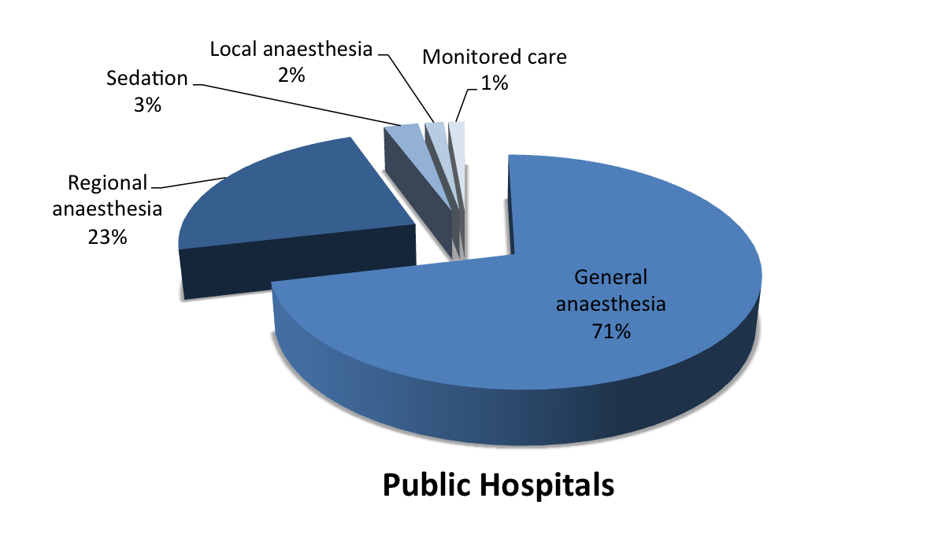
Type of anaesthesia care
Notes:
We have data on techniques used but won’t go into detail today. Number of GA’s in Public hospitals will be used as denominator for NAP5 incidence of AAGA.
With an estimated population of 4,58 million 2011 census [Ref CSO], our data suggest ~6.2 general anaesthetics per 100 population. This is similar to the 5-5.4 general anaesthetics per 100 population estimated during the NAP4 UK snapshot by Cook et al
During verification process of multiplication factor we compared our estimated no of GA’s in Public with HIPE and it was only 1.9% more then HIPE figures. This could be explained by the more robust method of data collection ie. done by anaesthetist prospectively rather then retrospectively by administrative staff.
Straight onto “Whom” (again only looking at Public Hospitals)

Slide 62
Population of 4.58 million (2011 census)
Incidence GA procedures /100 pop/year
6.5 Cw 5.4 ( NAP4 UK snapshot)
DENOMINATOR 187,000 GAs

Slide 63
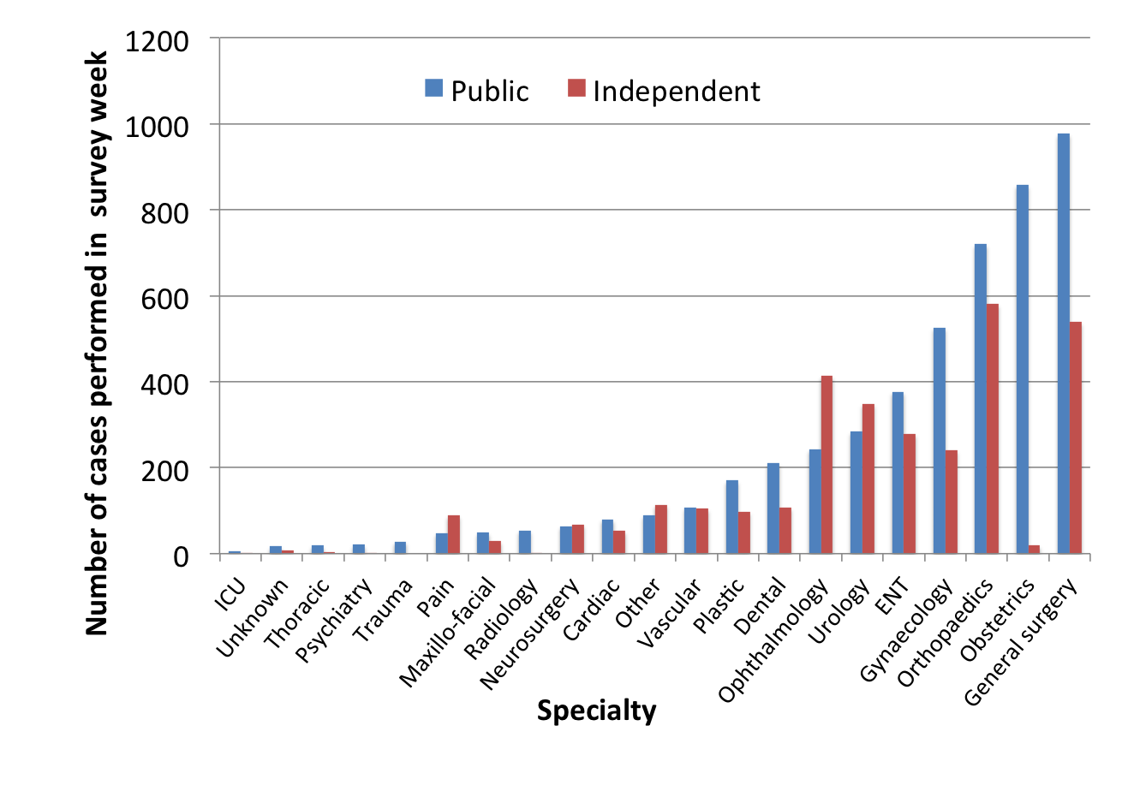
Notes:
Specialties displayed in increasing numbers performed in Public hospitals
Few where > done in Independent hospitals Pain, Opth, Urology
Note Obstetrics only 3% in Independent
Looking further into the Where?

Slide 64
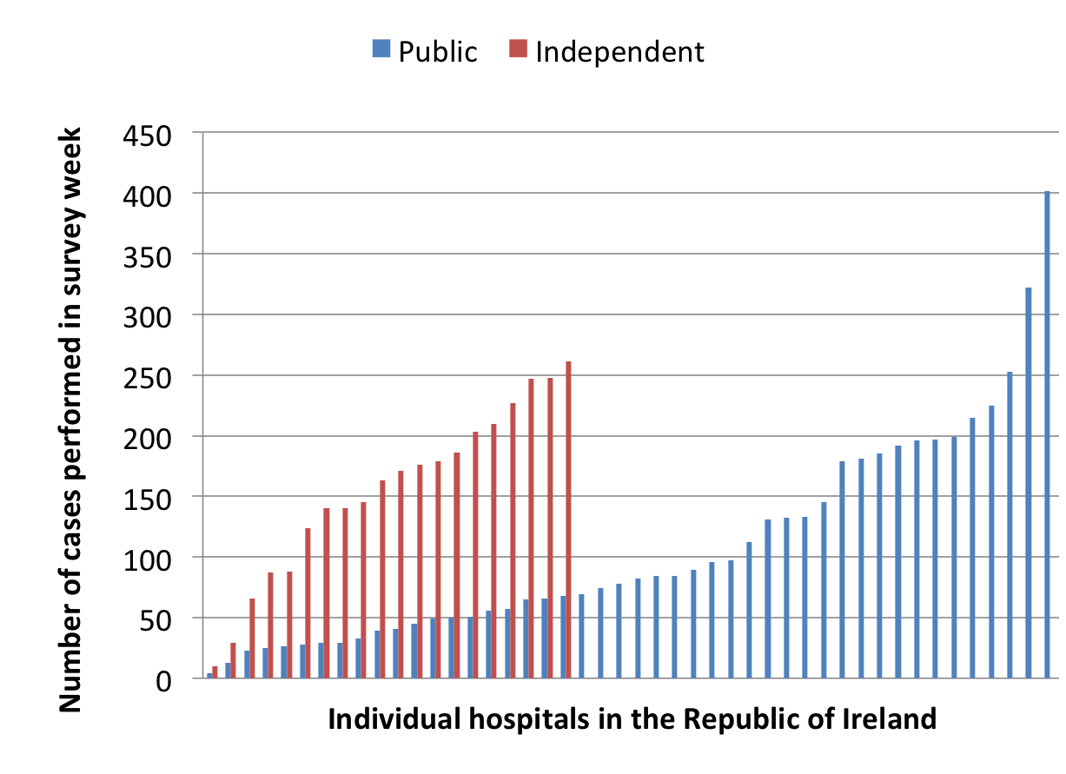
Notes:
Independent 10 and 261 (mean 155, median 167) per hospital. Three quarters of hospitals had more then 100 cases (6 hospitals performing more then 200 procedures) ~5000/year
Much wider distribution found in the Public hospitals: 4 and 402 (mean 107, median 80) per hospital. In contrast to the Independent hospitals, the majority (29, 63%) of Public hospitals had less then 100 cases, with only 5 (11%) hospitals performing more then 200 procedures.
For the remainder of the presentation I’ll be focussing on the PH unless stated otherwise.
A closer look at anaesthetic staff numbers obtained during the NAP5 baseline survey were plotted to each of the 41 anaesthetic departments total number of cases performed in hospital or hospital covered by the department we have this figure.

Slide 65
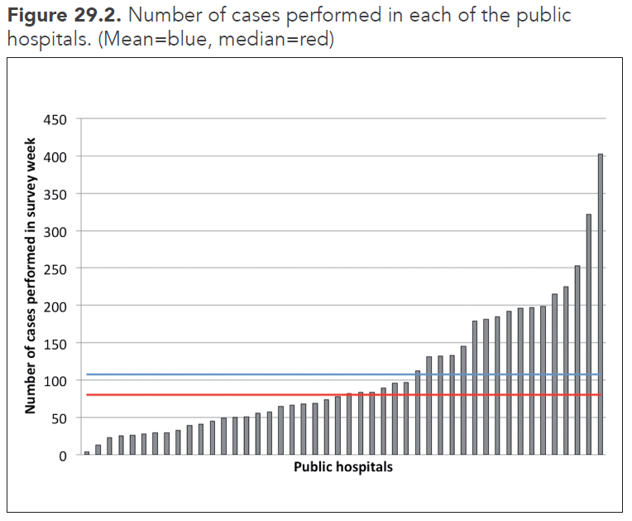
Many small public hospitals

Slide 66
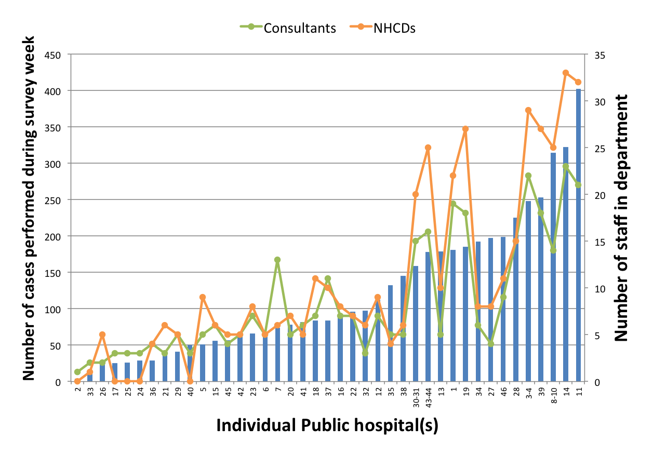
Notes:
Total anaesthetic staff ranged from 1 to 56.
Total Consultants 342 Total NCHDs 430
I have to point out that these were not WTE but in fact the actual number of staff members
Discuss joined sessions and fact that complexity of cases aren’t reflected in this
These figures include Pain/ICU staff
Interesting that 5 departments reported that they had no NCHDs (all of them had less then 50 cases during the week)
Tendency to be more NCHDs then Consultants
When looking at total number of anaesthetic staff

Slide 67
Staffing Ire vs Uk
IRE 342 Consultants (4.58.million)
UK 8,672 Consultants & SAS (63.2 million)
Senior Anaesthetists per head of population
1: 13,415 (Ire) vs 1: 7,287 (UK) Anaesthetic
Procedures/consultant/year
IRE ~720 (NAP5) vs UK ~450 (NAP4)
Notes:
No of senior consultants in Irish hopsuitals in half that I UK.
As data collection included both Public and independent hospitals the survey provides a unique comparison of caseload - both in terms of activity and case-mix - in Ireland. This survey provides unique data regarding anaesthesia service in Public and Independent hospitals in Ireland.
provides additional complimentary information on anaesthesia services in Ireland. It also provides indicator of how the current staffing levels impact on delivery of anaesthesia services in Ireland when compared with the UK

Slide 68
Who? Where? When?
Who?
  Consultants presence high-76%
  NCHDs most senior staff after hours for 2/3 cases
Where?
  Public hospitals 61%
  Range 4-402 cases/week
  60% of public paediatric anaesthesia care occurs in non-Tertiary Paediatric hospitals
When?
  17% of activity occurs during non-routine hours

Slide 69
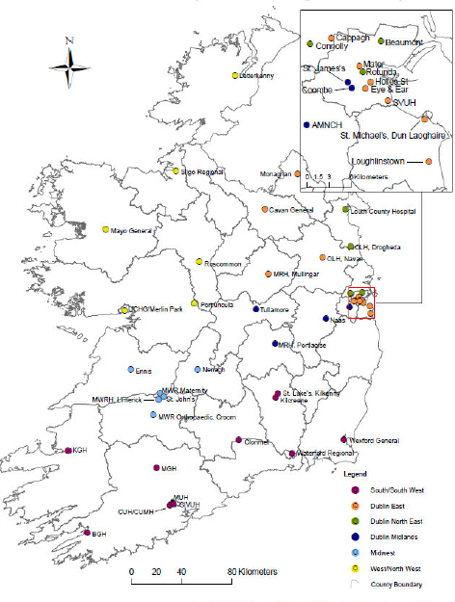

Reconfiguration of Irish Hospitals
Notes:
Activity rates vary widely across the Irish hospitals, both in terms of total caseload (range 4 - 402 cases per week) and caseload per consultant (range 4 – 49 cases a week per consultant in Public anaesthetic
departments). Notwithstanding case complexity
handled by individual hospitals, it seems
reasonable that the feasibility of the smaller units is currently under review by the governments’ hospital reconfiguration plan (Reilly, 2013)
ses for each group

Slide 71
NAP 5 Ireland--BASELINE
There were 8 new cases of AAGA that became known to consultants in 2011;
…….an estimated incidence
IRE ~1:23,000 (CIs wider)
UK ~ 1:15,000
A consultant anaesthetist would have one patient that experience AAGA every 36-47 years.
No hospital had policy to prevent or manage AAGA
Notes:
This provided an indication of how many cases of awareness the main NAP5 project could anticipate.

Slide 72
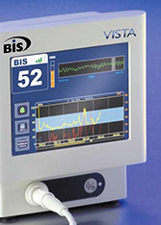
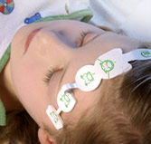
DoA Monitoring
Ire 80% hospitals possess DOA monitoring & ~62% use it.
UK 61% hospitals possess DOA monitoring &~ 25% use it.
Routinely used in 7.7 % IRE cw 2.9% UK.
None was used in any of the AAGA reports in Ireland
(Isolated Forearm Technique—not used in IRE)
Notes:
80% of public hospitals had access to DOA monitors
Only used in 9% of the cases (only used in 4.8% of independent hospitals)
The Irish (black) and UK (red) data plotted on the same axes (data taken from Fig. 3 above and from Fig. x of ref y). The graph shows the relative influence of denominator value of the number of general anaesthetics administered annually, on the estimated mean incide
, and
it could be argued that this is because their
use was generally sufficiently high as to be
preventative.

Slide 74
AAGA in Ireland
11 cases of AAGA
OVERALL INCIDENCE 1: 20,000
five in Class A (certain/probable)
one in Class B (possible)
two cases involving drug errors (Class G)
one case of “Sedation” (Class C)
two “Statement Only” cases.
Notes:
NAP% received 11 reports of AAGA.

Slide 75

Notes:
Incidence if similar if MORE UNCOMMON than estimates in UK
BUT there were similar disparities between calculate incidences in pts receiving NM blockers –1; 15,000 versus when they were NOT..(1:110)
However this shows that there were

Slide 76
AAGA in Ireland
6 cases classed as certain /probable and possible (one child under 5)
5 cases (83%) had NM BLOCK
2 cases at induction
  One RSI for C/S with thio –elective C/section
  Failure to turn on the vapouriser
None of the AAGA cases involved TIVA.
(2.3% GAs IRE vs 7.5% UK)

Slide 77
AAGA in Ireland
OUTCOMES
Tactile perceptions-2 cases
Paralysis & Distress-3 cases (Michigan 4D)
Pain & Distress-1 case (NMB)
HUMAN FACTORS
Contributed to 4 cases e.g. mind the gap/inadequate dose/2 cases of drug error.

Slide 78

Drug error

Slide 79
Summary
NAP5 linked but parallel project in Ireland.
The quantitative analysis of baseline, activity survey & reports of AAGA were very similar to UK
The qualitative analysis of the 11 reports of AAGA in Ire shows a remarkable similarity to those observed in UK both in detail & themes emerging.

Slide 80
Summary
First ever large scale anaesthetic audit in Ireland & first study on AAGA
Involvement whole anaesthesia community
100% participation from all anaesthetists & hospitals

Slide 81
Conclusions
The NAP5 Ireland report stands alone as an examination of the topic in a country separate from the UK.
The similarity in the outputs from Ireland to those from UK serves to validate the process.

Slide 82

Next steps….
Salus Dum Vigilamus
Will lead to implementation of recommendations….to benefit patients & anaesthetists…….
Stepping stone to other national/international audits
Notes:
Ireland is well served in anaesthesia by having the strength of two large bodies to guide us.
The College Arms, reproduced on the front cover, were granted in December 1999.
The shield contains lots of poppy heads; the cloud symbolises the drift to the other side (unconsciousness) with the healing hand of the physician in attendance. The Supporters, in the form of dolphins, are unusual and were granted for the first time in Ireland. They are contained on the "MacDonnell of the Glens" Coat of Arms and in heraldic terms provide a link to the administration of the first anaesthetic in Ireland by John MacDonnell, on January 1st 1847, in the Richmond Hospital, Dublin.
The natural intelligence of Dolphins is acknowledged. the Harp of Ireland in the figure Nike (victory) associated with overcoming disease.
The wording underneath "Salus Dum Vigilamus" is literally translated as "safety while we watch" - which speaks for itself.
Primary AIM of book organisations is to ensure-- PATIENT SAFETY….

Slide 83


